Slide 1
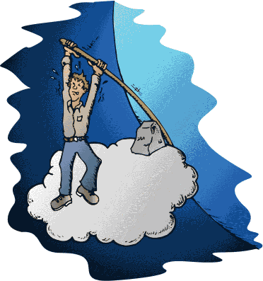
The Wisdom Council creates a “We the People”
Jim Rough
Sept 2010
www.WiseDemocracy.org

Slide 2

Society is facing
BIG problems
Money crisis … pressure on middle class
Global warming
Increasing threat of terrorism
Declining natural resources … oil, fish, etc.
Jobs going overseas
Money dominates politics, etc.

Slide 3

“To transform the problems of our society “we need to…”
Wait a minute! … The answers are easy. The problem is … there is no “We”.
How can “We” exist so “We” can solve the problems?

Slide 4

There are different “We’s.”
One is crucial!
We #1 = lots of us, as individuals
  We need to … “wake up, face our problems, care about them and choose to act.”
We #2 = lots of us, like a team
  We need to … “build political will to change policies and modify our system.”
We #3 = We the People
  All of us co-create our system
  As “We the People,” we are empowered to act

Slide 5

“We the People” is
All of us acting together as one …
Choosing the issues to address
Being creative and collaborative
Reaching unanimous conclusions that work for everyone
New Answers
Transformation

Slide 6
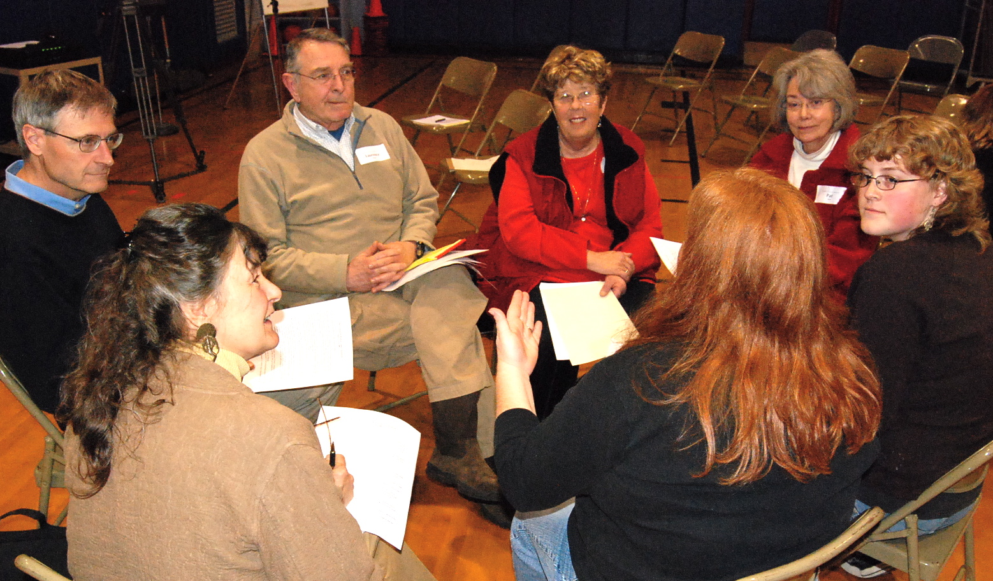
“We the People” requires the kind of thinking ...
Where each person is authentic, addresses the BIG issues collaboratively and creatively, and seeks unanimous answers that work for all.

Slide 7

Choice-creating is like dialogue & deliberation … but different
Deliberation
Dialogue
Negotiation
Problem-solving
Discussion
Choice-creating
Decision-making
Consensus-building
Creative thinking
Critical thinking
Systems thinking
Reasoning

Slide 8
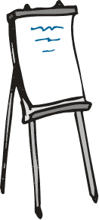

“Dynamic Facilitation” assures Choice-creating
It’s different because it follows energy more than an agenda or guidelines … with no judgment
It uses four charts:
  Solutions
  Concerns
  Data
  Problem-statements
It can seem chaotic but achieves magic through shifts & breakthroughs
People reach unanimous conclusions in the spirit of “We”

Slide 9
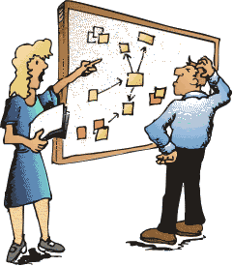
“We the People” requires all of us solving big issues together
We take “time out!” and face the Big issues
The conversation is choice-creating
  Unanimous win/win conclusions
  Systemic, thoughtful solutions
  Individuals grow in capability and uniqueness
  The spirit of community
Also required:
  A few of us can start it
  Low cost/risk
  It’s ongoing

Slide 10
The “Wisdom Council” is proving it can approximate this ideal
1) Creates a symbol of “We the People”
  Random sample of 12
  They choose the issue
  They reach unanimous conclusions
2) Involves everyone over time
  Periodic community gatherings
  The symbol of “we” presents “our” story
  The people engage in dialogue and deliberation
  All can see
3) Is ongoing
The Secret ingredient that makes it all work is the quality of thinking … Choice-creating!

Slide 11
Demonstration of
Dynamic Facilitation
Start with a key issue … Impossible-to-solve is ok
Use lists of … Solutions, Data, Concerns, Problem-Statements
Purge! … Help people speak their truth
Protect! … From all forms of judgment
Reflect! … People see what they are really saying
Follow energy … Solutions usually come first
Help bring closure

Slide 12
Review the Demonstration
Context …
1. How big is the issue? … Impossible? Emotional? Conflicted?
2. How much time was available? … short? long?
How many people? … small? large?
How diverse a group? … Left/Right? Cultures?
Process …
Was “everyone” involved?
Were people authentic and passionate?
Did people listen with respect?
4. Did people grow in their perspectives?
5. Did divergent opinions hinder? … or help?
6. Was “Choice-creating” evident?
Results …
Did points of consensus develop?
Did people develop more wisdom and clarity?
Did trust develop … a sense of “we”?
Were there shifts? .. breakthroughs?
Were there any action items?

Slide 13

Normal meeting processes MUTE Choice-creating
They aim instead for …
Limiting the scope of issues ... vs. Unlimited
Logic and judgment … vs. Creativity
Emotional detachment … vs. Passion
Predictable progress … vs. Shifts/Breakthroughs
Strict agenda … vs. Energy-focus
Managed change … vs. Transformation
Incremental results … vs. Emergent

Slide 14
Dynamic Facilitation opens new doors of possibility
Solving impossible problems
Conflict resolution
Organizational transformation
We the People and “Wise Democracy”

Slide 15
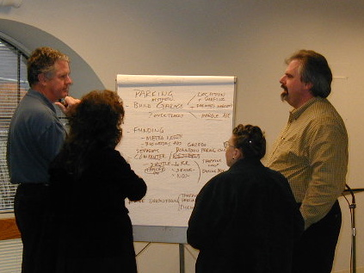
WC: Pleasantville, NY
Specific strategy for the town
Notes:
We need to become a real community instead of a bedroom community:
1) Create a center of town
traffic flows, awnings, parking
2) Move the train station outside of town and move the parking for it too
3) Create a reason for youth to stay in the town … turn x building into a community secener.

Slide 16
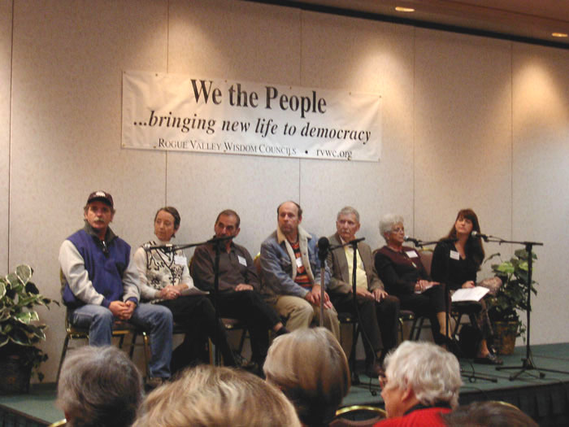
WC: Rogue Valley OR
Changing the town charter

Slide 17
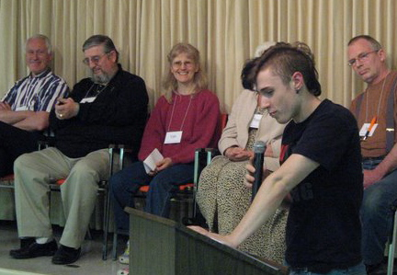
WC: Victoria BC
People taking action

Slide 18
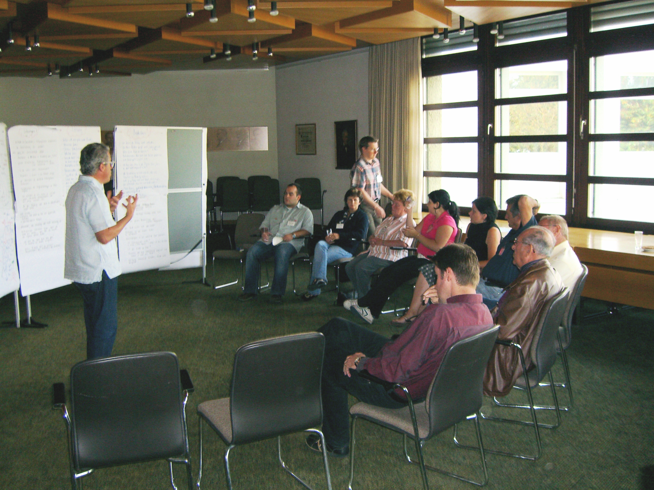
WC: Wolfurt Austria
National environmental prize

Slide 19
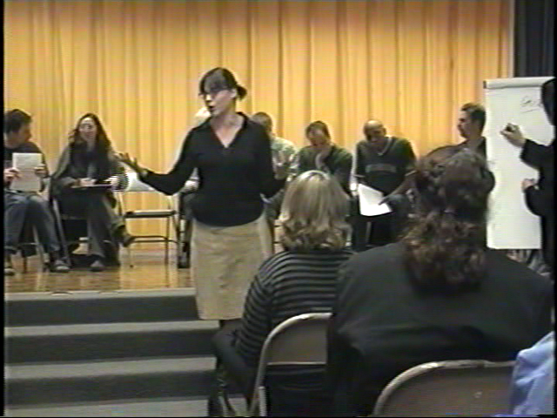
WC: Elementary School Building a culture of trust

Slide 20
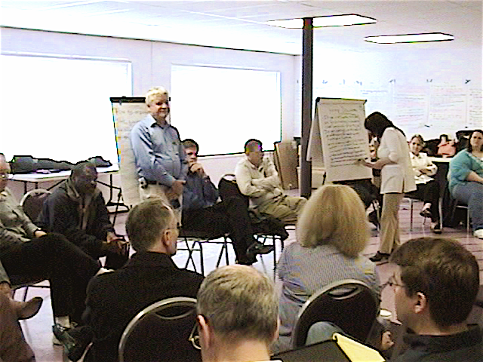
WC: Dept. of Agriculture
Create a culture of safety

Slide 21
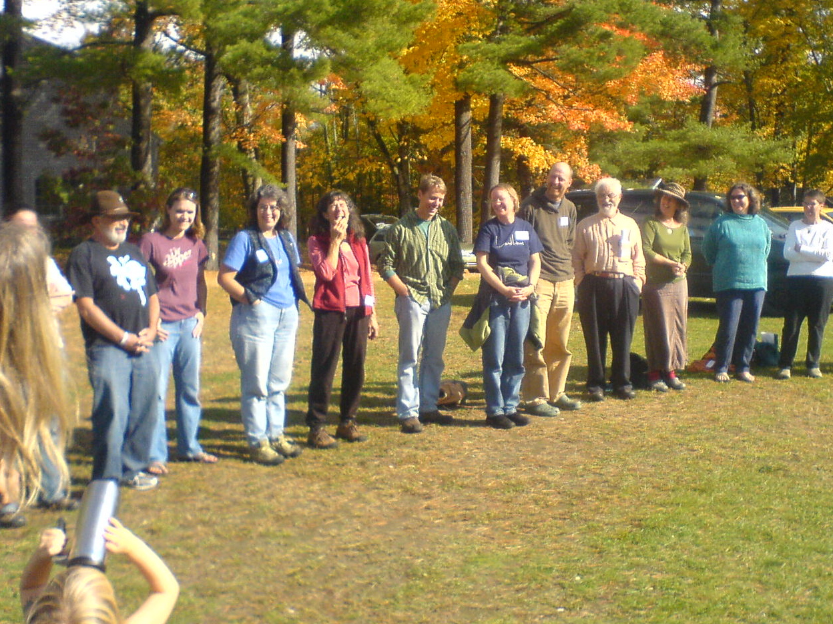
WC” in a conference
“The Great Turning”

Slide 22


Frequently Asked Questions …
What about the apathetic people?
What about dumb or uninformed people?
What about the powerful folk in charge, who will resist this change?
Won’t people lose their individuality if all reach unanimous answers?
How do you reach unanimity with millions of people?

Slide 23

Sum
Here is a suggested strategy for transforming our system to become sustainable, for solving the biggest issues we face in the short term, for releasing the best in people and achieving a society that works for all
It is accessible, inexpensive, low cost, low risk, systemic and non-threatening to government, deliberative democracy, and even special interests.
The problem … is that it is NEW. It’s “out of the box” so people’s first reaction is to say “it won’t work”
Experiments with the Wisdom Council say “it works!”
We need resources to make it happen at all levels

Slide 24
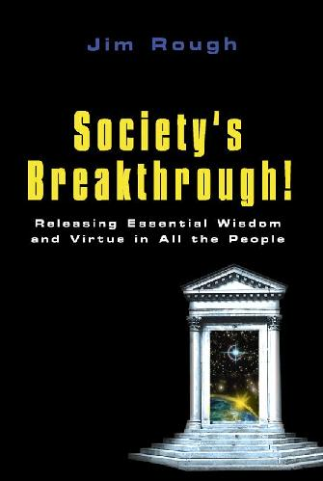
Learn more
www.SocietysBreakthrough.com
  Book: “Society’s Breakthrough!”
www.WiseDemocracy.org
  Center for Wise Democracy
www.DynamicFacilitation.com
Dynamic Facilitation Seminars

